Slide 1
CUSTOMER QUALITY PREDICTION
BY: VITHIKA AGRAWAL

Slide 2

Key KPIs and Recommendation
Months to contact
Preferred Contact Type
Not contact previous customers
Higher CPI customers
March, September, August, October and April are the best months for getting good responds from the customers.
Customers should be contacted via Cellular phones for getting best results
Targeting customers with higher CPIs will give better response to the marketing campaigns
Customers who have been contacted previously before the campaign should not be contacted as it can reduce the response rate.

Slide 3




PROJECT OUTLINE
STEPS TAKEN TO CREATE THE AWESOME MODEL
DATA PREPARATION
Consolidation, Transformation and Missing values
EXPLORATORY DATA ANALYSIS
Understanding the predictors
PREDICTIVE MODELLING
Logistic Regression, Decision Tree, Random Forest
RESULTS AND ANALYSIS
Profit and response prediction and which set of customers to contact to maximize profit

Slide 4

Handling Missing Data
DATA PREPARATION
STEPS TAKEN TO PREPARE THE DATA TO GET THE BUSINESS SOLUTION
Imputed missing data in customer age, schooling and days of weeks
Feature Selection on the basis of Correlation
Dropped highly correlated variables with the threshold of more than 80% correlation
Handling Categorical Variables
One hot vectors, binary encoding
Balancing the data using SMOTE
Balancing the highly unbalanced data using SMOTE Technique

Slide 5
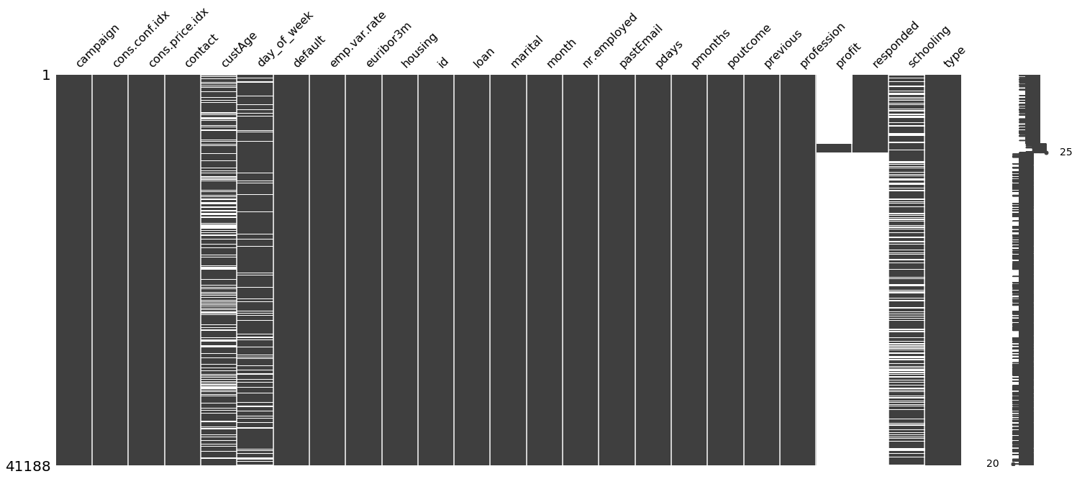
Handling missing values
Missing data were present in custAge, day_of_week and schooling columns in the dataset. The missing values were huge and hence, imputation was necessary and dropping the variables didn’t make sense.
Schooling was imputed with the median values on the basis of the level of education
Age was imputed with the median values on the basis of the level of education, job type and marital status
Day_of_week were filled randomly as the categories in the data were approximately equally distributed.

Slide 6
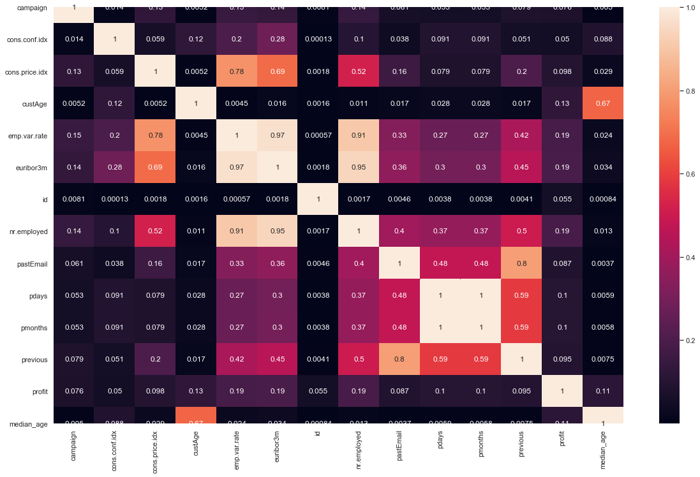
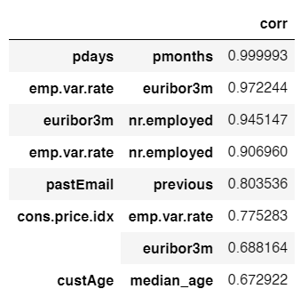
Handling highly correlated values
Removed highly correlated variables with the threshold of 80%.

Slide 7
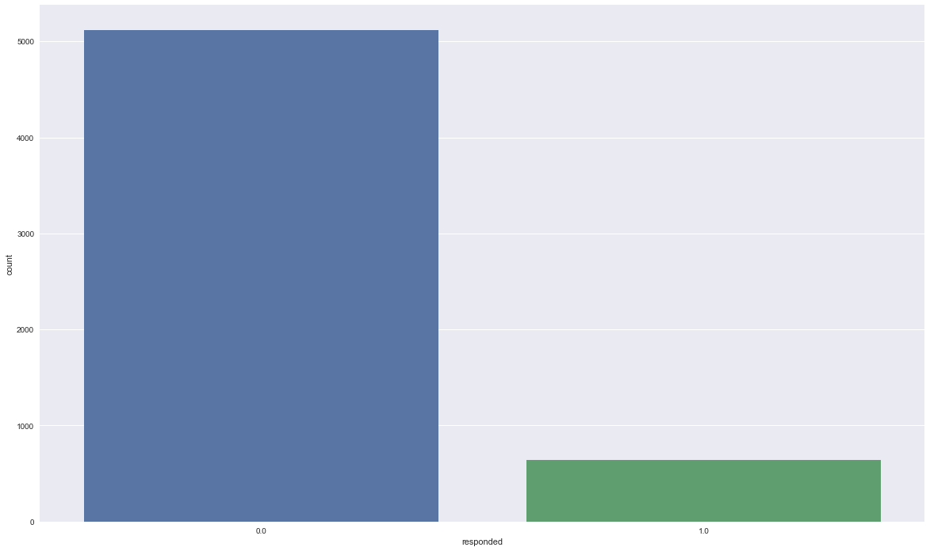
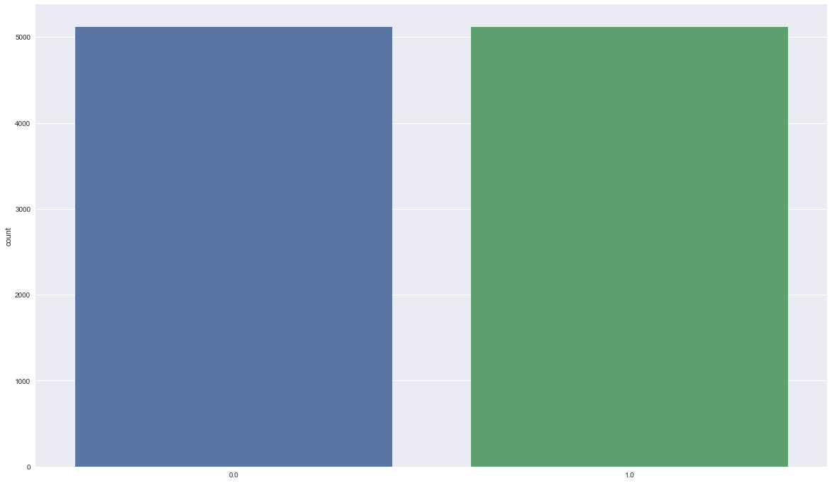
Balancing data using SMOTE technique
The percentage of negative and positive response to the marketing campaign were 88.83% and 11.17% respectively. This imbalance is needed to handled for more accurate prediction.
Using over-sampling technique of SMOTE, the imbalance of the data were handled. The oversampling technique was used here to resolve the issue of over-fitting of the data while using various classifier techniques

Slide 8
EXPLORATORY DATA ANALYSIS

Slide 9
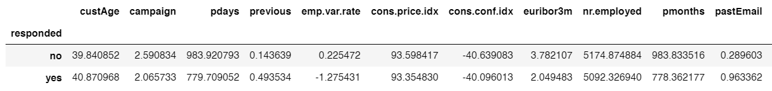
Observations from EDA
The mean age of customers who are responding and not responding lies in the age group 39-41 years.
On an average, the number of times the customers were contacted was 2-3 times. It seems that campaign is not a very important variable for predicting the response.
The pdays (days since the customer was last contacted) is understandably lower for the customers who responded to the marketing campaign. The lower the pdays, the better the memory of the last contact and hence the better chances of response to the marketing campaign.

Slide 10
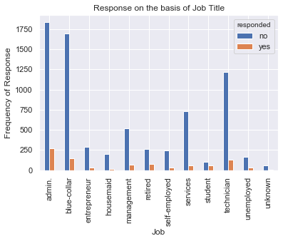
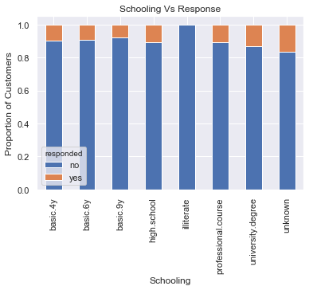
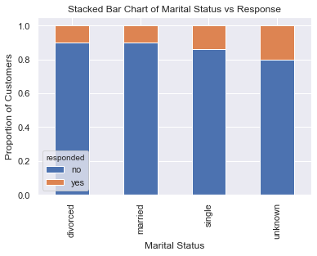
Observations from EDA
Technicians, admins and blue collars respond the most to the marketing campaigns while housemaid, unemployed and students respond the least to these marketing campaigns
Illiterate person doesn’t respond to the marketing campaigns at all
A person who is single responds the most to the marketing campaigns as compared to a divorced or married person

Slide 11
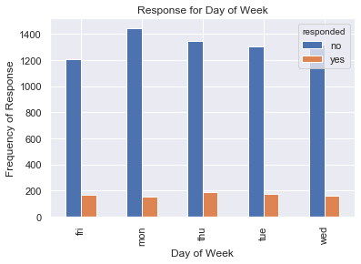
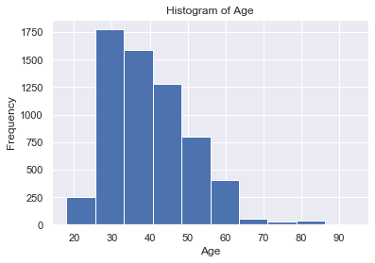
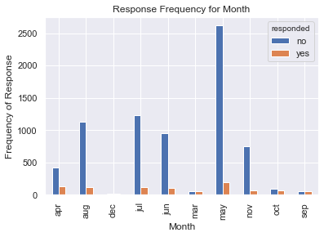
Observations from EDA
The response of the customers doesn’t vary according to which day they have been contacted. However, it does vary with respect to the months they have been contacted.
The Age of the customer is highly skewed to the right. This suggests that this column contains outliers.
With respect to the months, the customers are least likely to respond in the month of May, followed by July and August.

Slide 12

PREDICTIVE MODELLING
PREDICTING THE RESPONSE
Implemented logistic regression, decision tree and random forest model to evaluate the best model for prediction. Predicted the response variable using logistic regression
EVALUATING THE KPIs USING SAS
Implemented logistic regression in SAS to find insights on which set of customers the marketing firm should contact to maximize profit
PREDICTING THE PROFIT
Implemented linear regression and decision tree to evaluate the best model for prediction. Predicted profit using linear regression

Slide 13
ANALYSIS AND RESULTS

Slide 14
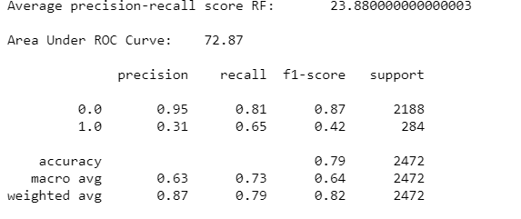
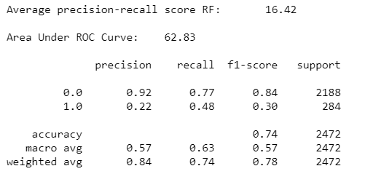
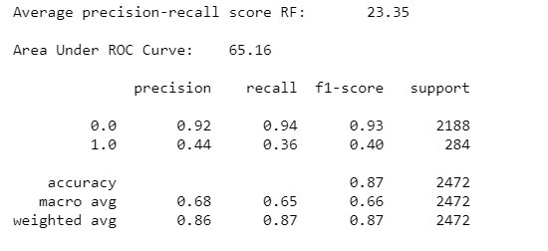
Model Evaluation for Response Variable
Logistic Regression
Random Forest
Decision Tree
Three models – Logistic Regression, Decision Tree and Random Forest were implemented to evaluate the best classifier.
When comparing the results of the model, Logistic Regression was able to classify the correct positive response rate better than the other models(Recall score = 65% ) and there fore this model was chosen to predict the response rate.

Slide 15
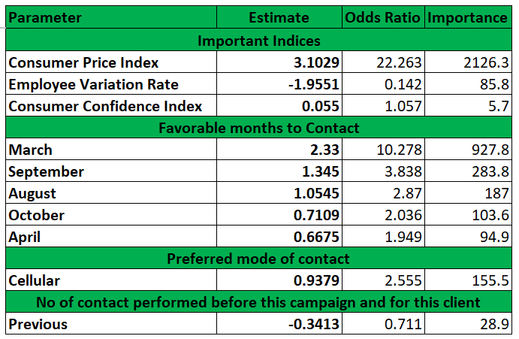


Effect of Variables on Response
The GOOD
Consumer Price Index – A customer with higher CPI are 22.26 times more likely to respond to the marketing campaigns.
Favorable months to contact - A customer contacted in the month of March are 10.28 times more likely to respond to the marketing campaign, followed by September, August, October and April.
Preferred mode of contact – A customer contacted via Cell phones are 2.5 times more likely to respond to the marketing campaign
The BAD
Employee Variation Rate – Customers who have high EVR are 0.14 times less likely to respond to marketing campaign
Previous – Customers who have been contacted previous to the campaign are 0.71 times less likely to respond to the marketing campaign

Slide 16
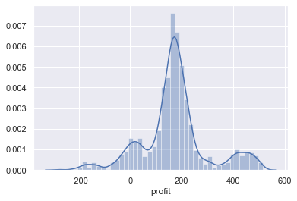
Model Evaluation for Profit Variable
Two models – Linear Regression and Decision Tree were implemented to evaluate the best regressor.
When comparing the results of the model, both Linear Regression and Decision Tree Regressor was able to explain 93% of the data. Hence, Linear Regression was used to predict the profit for those who responded to the marketing campaigns

Slide 17
Key KPIs and Recommendation
Months to contact
Preferred Contact Type
Not contact previous customers
Higher CPI customers
March, September, August, October and April are the best months for getting good responds from the customers.
Customers should be contacted via Cellular phones for getting best results
Targeting customers with higher CPIs will give better response to the marketing campaigns
Customers who have been contacted previously before the campaign should not be contacted as it can reduce the response rate.

Slide 18



Tools Used

Slide 19
THANK YOU !!

